Slide 1
Task 1: Deploy Extended Blocks
James Ocampo

Slide 2
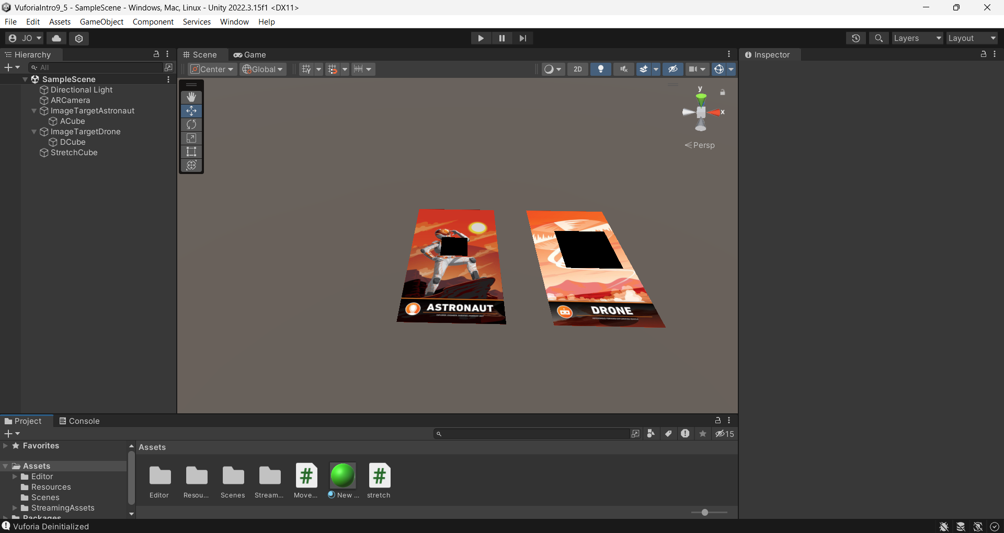

Unity Setup:
ImageTargetAstronaut
ACube
ImageTargetDrone
DCube
Stretch Cube

Slide 3
StretchCube’s Script Component - Stretch.cs
using UnityEngine;
public class stretch : MonoBehaviour
{
public Transform cube1; // Will Set Up in the Next Step
public Transform cube2; // Will Set Up in the Next Step
void Update()
{
// Calculate the center position between cube1 and cube2
Vector3 centerPosition = (cube1.position + cube2.position) / 2f;
// Set the position of the stretchcube to the center position
transform.position = centerPosition;
// Calculate the distance between cube1 and cube2
float distance = Vector3.Distance(cube1.position, cube2.position);
// Set the scale of the stretchcube along the axis connecting cube1 and cube2
transform.localScale = new Vector3(transform.localScale.x, transform.localScale.y, distance);
// Rotate the stretchcube to align with the line between cube1 and cube2
transform.LookAt(cube2.position);
}
}

Slide 4
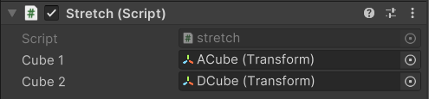
Attach Image Target Cubes to the StretchCube’s Script Component
ImageTargetAstronaut
ACube
ImageTargetDrone
DCube
Click and Drag objects from Hierarchy Into the Stretch Cube’s Script Component

Slide 5
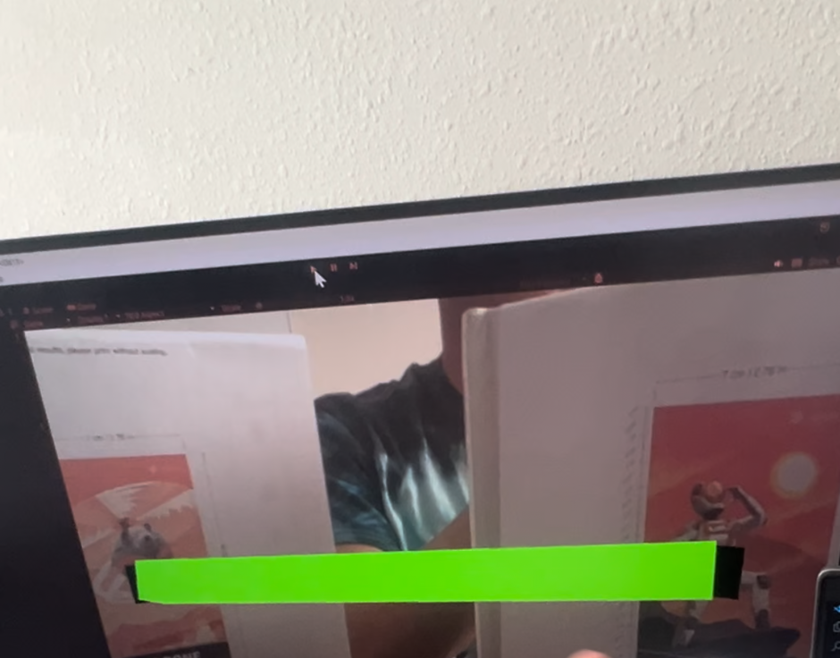
Final Result

Slide 6
Extra Functionality - Focus on Table Movement
I imagined that the viewable area of the robot changes based on the direction the robot is facing which should thus be reflected if the project is attempting to allow the robot to change where it is looking.
For now, I created a Movement Script to simulate this and attached it to the ACube.
The code allows the user to change where the ACube located relative to the center of the Image target via WASD keys.
Please see next page for the code.

Slide 7
ACube’s Script Component - Movement.cs
using UnityEngine;
public class Movement : MonoBehaviour
{
[SerializeField] // Allows Speed Variable to be seen in the Unity Editor
private float speed = 10.0f;
// Update is called once per frame
void Update()
{
WASDMovement();
}
// WASD Movement (2D XZ Plane)
void WASDMovement()
{
float horizontalInput = Input.GetAxis("Horizontal");
float verticalInput = Input.GetAxis("Vertical");
transform.Translate(Vector3.right * horizontalInput * Time.deltaTime);
transform.Translate(Vector3.forward * verticalInput * Time.deltaTime);
}
}

